Slide 1
AUTOPILOT DEMO
13th ITS European Congress
Helmond
Week 23, 2019

Slide 2
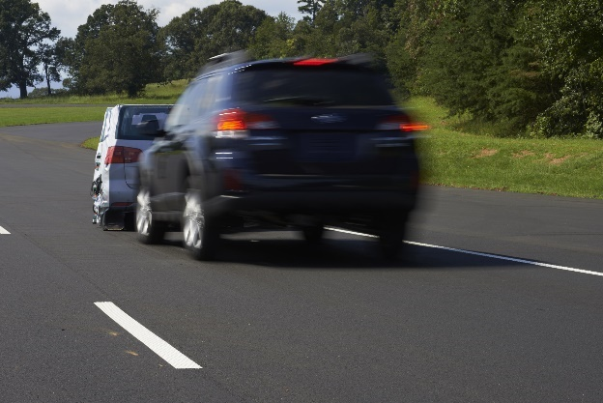

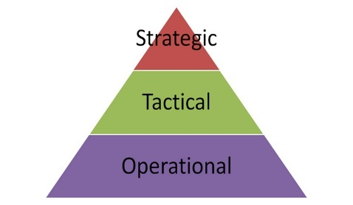
The AUTOPILOT Challenge
Demonstrate added value of
Internet of Things for Automated Driving
Internet stuff
???
Internet of Things:
Information beyond reach of sensors
Data in context (e.g. trustworthiness)
Anything connected as source
Automated Driving:
Travel planning
Decision making
Steer and speed control

Slide 3
The AUTOPILOT project
H2020 EU Project
Large Scale IoT Pilots in 6 countries
about Connected and Automated Driving with
44 partners under coordination of ERTICO
TNO coordinates Pilot in the Brainport NL
involving 15 partners
3 Years Innovation Action:
01/01/2017 – 31/12/2019
Project costs: 25 m€ - EU contribution: 20 m€

Slide 4
















Brainport
In the Brainport area (Eindhoven-Helmond), 5 use cases are considered:
  CAR SHARING
  AUTOMATED VALET PARKING
  HIGHWAY PILOT
  PLATOONING
  Urban Driving
IoT sources: connected vehicles, road-side cameras, traffic lights, drones smartphones and wearables

Slide 5
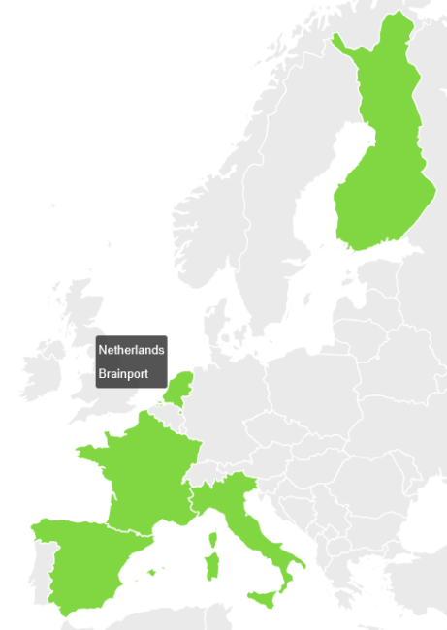





AUTOPILOT project
(Automated driving Progressed by Internet Of Things)
Internet of Things (IoT): connecting anything, anytime, anyplace,
using any service over any network
Aim: develop a range of driving services, which take
advantage of the potential of IoT to improve automated driving
4 different driving modes in various configurations
Urban driving
Automated
valet parking
Platooning
Highway
pilot

Slide 6
Àutomated Driving functions in summary
Automated Valet Parking
  Vehicles driving automatically to parking spots, and collect from the parking
Highway pilot
  Detection of road incidents to ensure safe automated driving on highways
Platooning
  Automated (short-distance) following of vehicles for more efficient traffic and comfort
Urban Driving
  Detection of pedestrians and cyclists, and managing traffic lights with automated driving

Slide 7




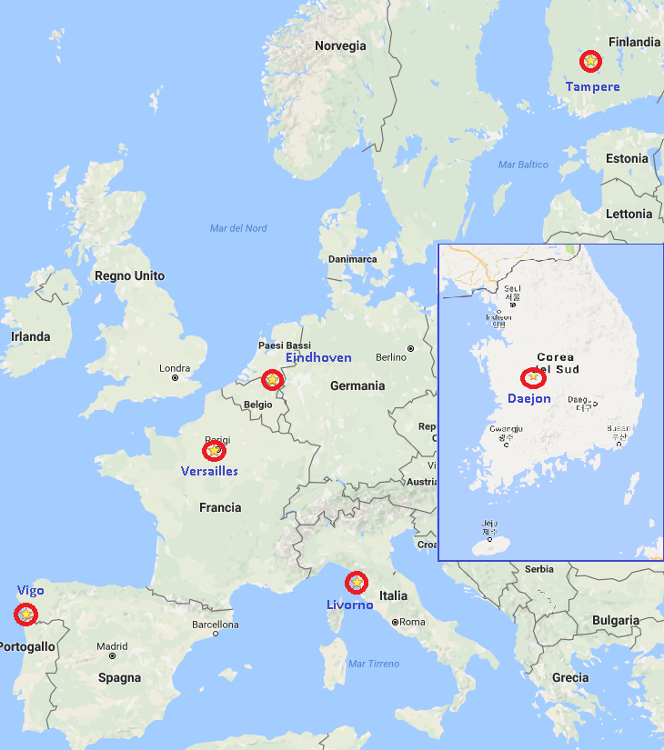




7
Brainport, NL
Automated Valet Parking
Highway pilot
Platooning
Urban Driving
Tampere, FI
Automated Valet Parking
Urban Driving
Versailles, FR
Automated Valet Parking
Urban Driving
Platooning
Europe
Daejeon, KR
Urban Driving
Korea
Vigo, SP
Urban Driving
Automated Valet Parking
Livorno, IT
Urban Driving
Highway pilot
6 pilot sites

Slide 8
What will we demonstrate
The benefits of using Internet of Things
  Make AD available earlier (accelerating by lower cost, connect to IoT devices that are widespread, e.g. Smartphones)
  New AD possibilities (enabling new functions: AVP knows route and parking, platoon formation due to coordinated scheduling over long distance)
  Improve AD (enhancement of existing functions: Anticipation to information ahead (i.e. planned routes of vehicles) allows improvement of comfort/confidence in AD, reduces energy need and improve traffic flow

Slide 9











Driving modes and new services by AUTOPILOT
IoT enabled Services
Vulnerable Road User sensing
Automated driving route optimisation
Real time car sharing
Driverless car rebalancing
HD maps for automated driving vehicles
6th sense driving
Dynamic eHorizon
Driving Modes
Urban Driving
Highway pilot
Platooning
Automated Valet Parking

Slide 10
Driving modes and new services demonstrated
IoT enabled Services
Vulnerable Road User sensing
Automated driving route optimisation
Real time car sharing
Driverless car rebalancing
HD maps for automated driving vehicles
6th sense driving
Dynamic eHorizon
Driving Modes
Urban Driving
Highway pilot
Platooning
Automated Valet Parking

Slide 11
Today’s demonstration: 2 parallel sessions
Mobility Service demo
Platooning & AVP
(TNO, IBM, DLR)
Part A
pick-up
platoon formation & platooning
Explanation
AUTOPILOT demo
Q&A
AUTOPILOT demo
Automated Valet Parking (AVP)
Road Hazard Detection
VRU Anticipation
(DLR, NEVS, TU/e, VALEO, VTT)
Part B
15 mins
40 mins
5 mins

Slide 12
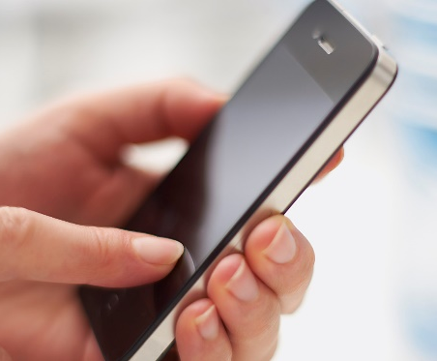

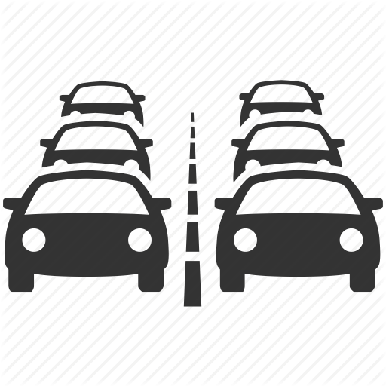




Part A: Mobility service demo – Public road
Integrated services
Book a car from a car sharing service
Get it using the AVP service
Find another vehicle for platooning using Platooning service
Drive in platoon supported by Platooning service
IoT sources: connected cars, roadside cameras, traffic lights
Automated driving modes: Platooning, AVP
U1
AVP
U1
Platooning
U2
U2
User 1
Platooning service
IoT platform
& services
Platooning service
User 2
User 2
User 1
IoT platform
& services
V2V
Guiding vehicles to become a platoon
Guiding vehicles while platooning

Slide 13
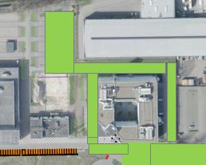





Part B: On-campus demonstrations
Individual services
Automated Valet Parking
Urban Driving
Highway Pilot (low speed)

Slide 14
Automated Valet Parking - NEVS
L_B1
L_B2
L_B3

Slide 15
Urban Driving (Guided AVP) - VTT
L_B1
L_B2
L_B3

Slide 16


Highway Pilot (Road Hazard Anticipation) - Valeo
L_C0
L_C4
L_C1
L_C3
L_C2

Slide 17

Urban Driving (VRU Anticipation) – TU/e
L_C1
A_C4
A_C3
A_C2

Slide 18
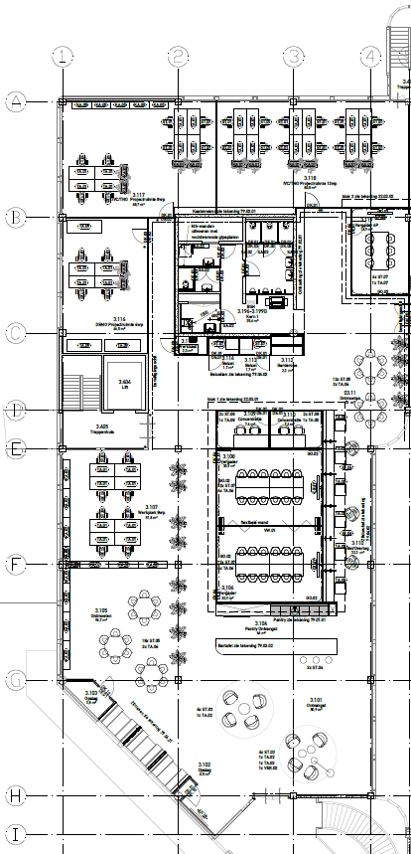
Splitting up now
Part A
(Mobility service demo):
  stay in this room
Part B (AVP, road hazard detection, VRU anticipation):
  follow AUTOPILOT staff to other room
Part B
Part A

